Slide 1


SMART-O-THON
Use slide show for better experience

Slide 2
SMART-O-THON
Domain : IoT and Embedded System
IoT Wizards
Members
TEAM NAME :
IDEA : eBrailleVision
IDEA : DIGITAL BRAILLE
Digital Braille display system
"Enabling Touch, Empowering Vision: Unlocking Braille's Digital Potential"

Slide 3
SMART O THON
SMART-O-THON
Team IoT Wizards
Members
IDEA : DIGITAL BRAILLE

Slide 4
SMART O THON
S DHANU 21BPS1074
IDEA : DIGITAL BRAILLE

Slide 5
SMART O THON
DHANU 21BPS1074
VENUKANTHAN B S 21BPS1592
IDEA : DIGITAL BRAILLE

Slide 6
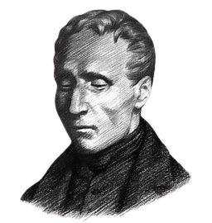
SMART O THON
HISTORY
DHANU 21BPS1074
VENU KANTHAN 21BPS1592
SHIYAM D T 21BPS1556
Team
IoT Wizards
Members
IDEA : DIGITAL BRAILLE

Slide 7
HISTORY
Team
IoT Wizards
Members
Louis Braille was a French inventor of a reading and writing system, named braille after him, intended for use by visually impaired people.
His system is used worldwide and remains virtually unchanged to this day.

Slide 8
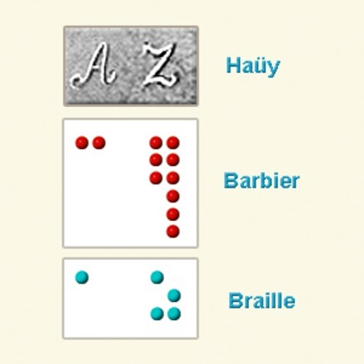
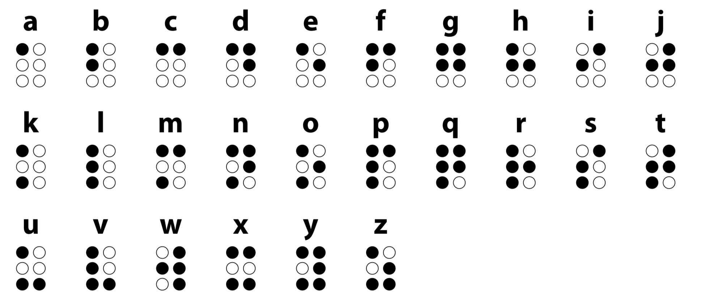
Goals and Objective
There are an estimated 8.4 million visually impaired people in India, including both children and adults. It is estimated that at least 200,000 children in India have severe visual impairment or blindness and approximately 15,000 are in schools for the blind ~National Institutes of Health (India)Our idea aims to develop a digital braille display system that revolutionizes the education of visually impaired children.
It allow blind individuals to identify and learn to read through touch.
The system was initially intended for military use, enabling soldiers to communicate silently at night. However, the Barbier System was complex and difficult to learn, limiting its practicality.
This system provided a greater number of possible combinations and was easier to learn and use. Braille's system revolutionized tactile communication and became the dominant method of reading and writing for individuals with visual impairments worldwide.
HISTORY

Slide 9
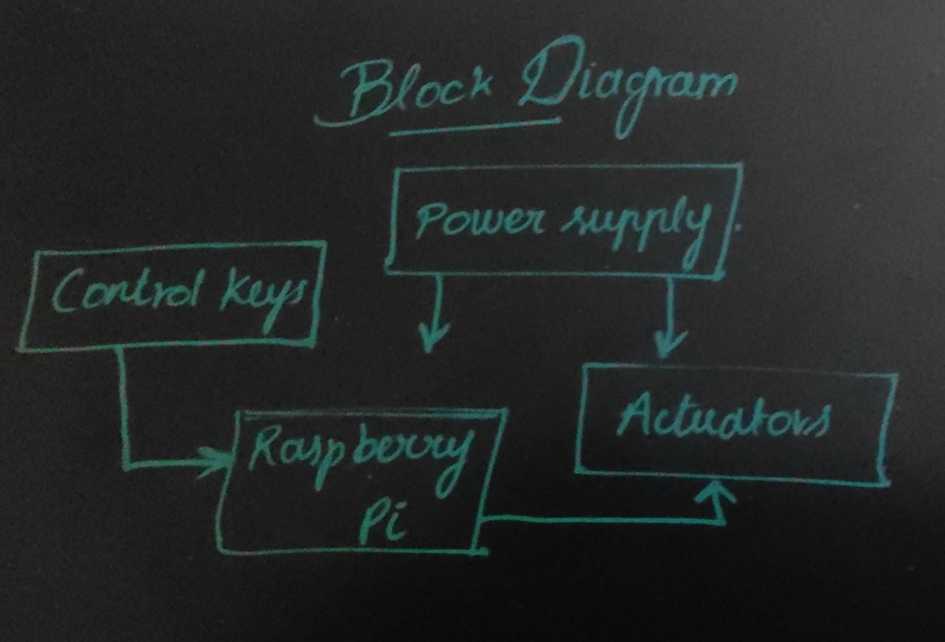
Goals and Objective
There are an estimated 8.4 million visually impaired people in India, including both children and adults. It is estimated that at least 200,000 children in India have severe visual impairment or blindness and approximately 15,000 are in schools for the blind ~National Institutes of Health (India)Our idea aims to develop a digital braille display system that revolutionizes the education of visually impaired children.
Braille Language

Slide 10
Goals and Objective
There are an estimated 8.4 million visually impaired people in India, including both children and adults. It is estimated that at least 200,000 children in India have severe visual impairment or blindness and approximately 15,000 are in schools for the blind ~National Institutes of Health (India)Our idea aims to develop a digital braille display system that revolutionizes the education of visually impaired children.
Block Diagram

Slide 11

Goals and Objective
COMPONENTS REQUIRED

Slide 12
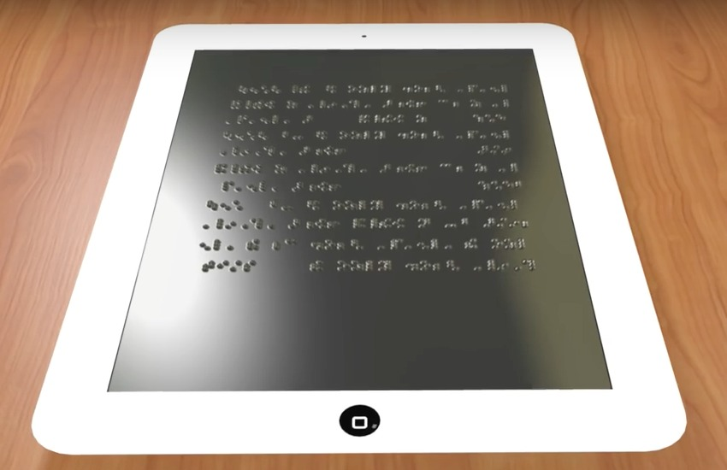
Goals and Objective
There are an estimated 8.4 million visually impaired people in India, including both children and adults. It is estimated that at least 200,000 children in India have severe visual impairment or blindness and approximately 15,000 are in schools for the blind ~National Institutes of Health (India)Our idea aims to develop a digital braille display system that revolutionizes the education of visually impaired children.
COMPONENTS REQUIRED
1. Raspberry pi 4
2. Servo
3. Jumper wire
4. Solenoid
5. 12V Supply
6. LCD Display
7. LED Matrix
8. Arduino

Slide 13
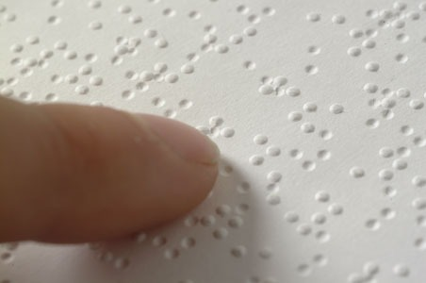

Goals and Objective
We really feel that one of consequences for blind people of not being able to access Braille is that they are limited in terms of the kind of science and mathematical things
There are an estimated 8.4 million visually impaired people in India, including both children and adults. It is estimated that at least 200,000 children in India have severe visual impairment or blindness and approximately 15,000 are in schools for the blind ~National Institutes of Health (India)

Slide 14
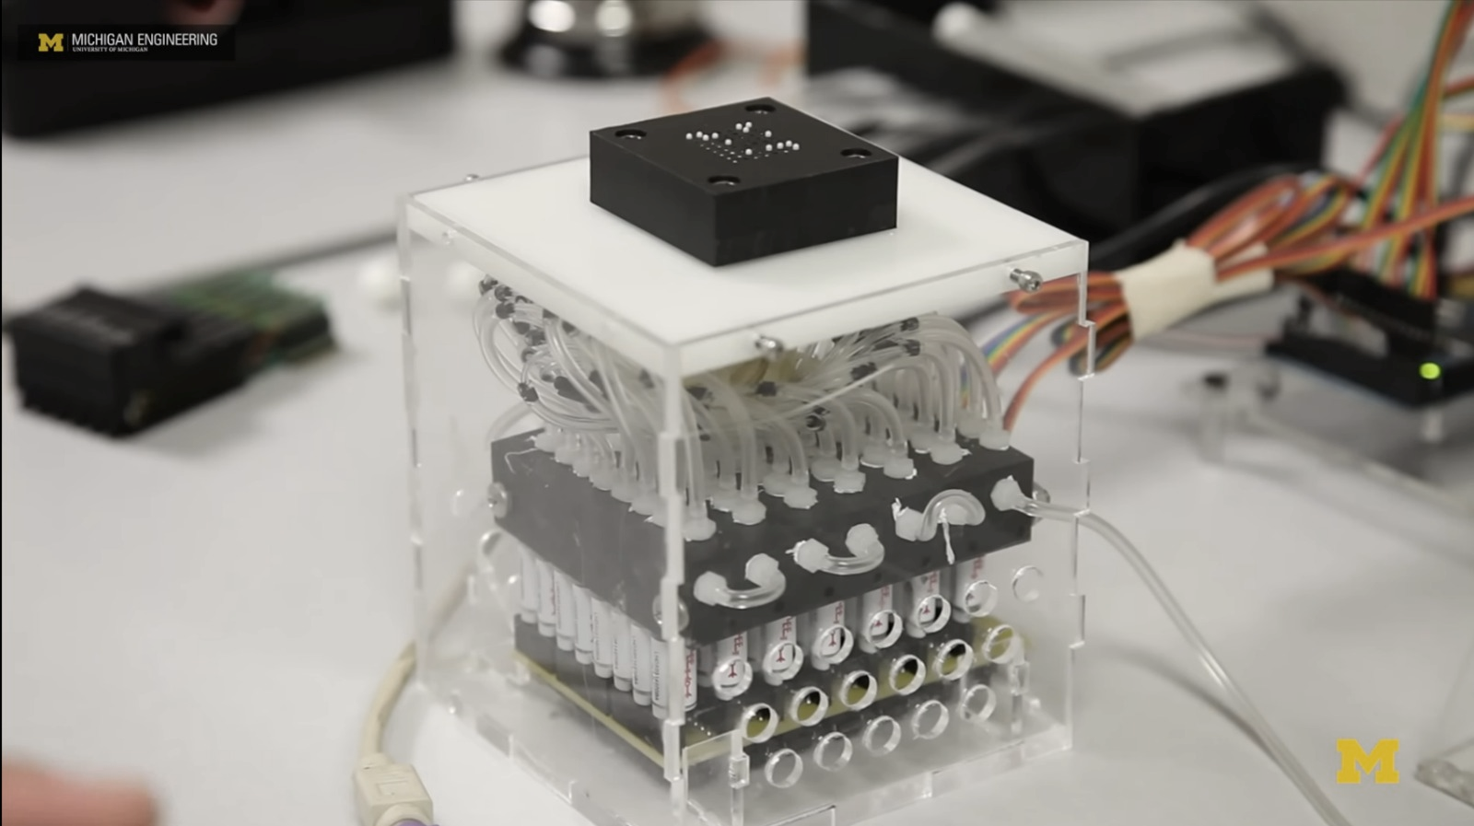
We really feel that one of consequences for blind people of not being able to access Braille is that they are limited in terms of the kind of science and mathematical things
8 years ago University of Michigan tried to create digital Braille system which is entirely pneumatic

Slide 15
8 years ago University of Michigan tried to create digital Braille system which is entirely pneumatic
Which means we have a series of bubbles which are inflated by fluid or air
We really feel that one of consequences for blind people of not being able to access Braille is that they are limited in terms of the kind of science and mathematical things

Slide 16

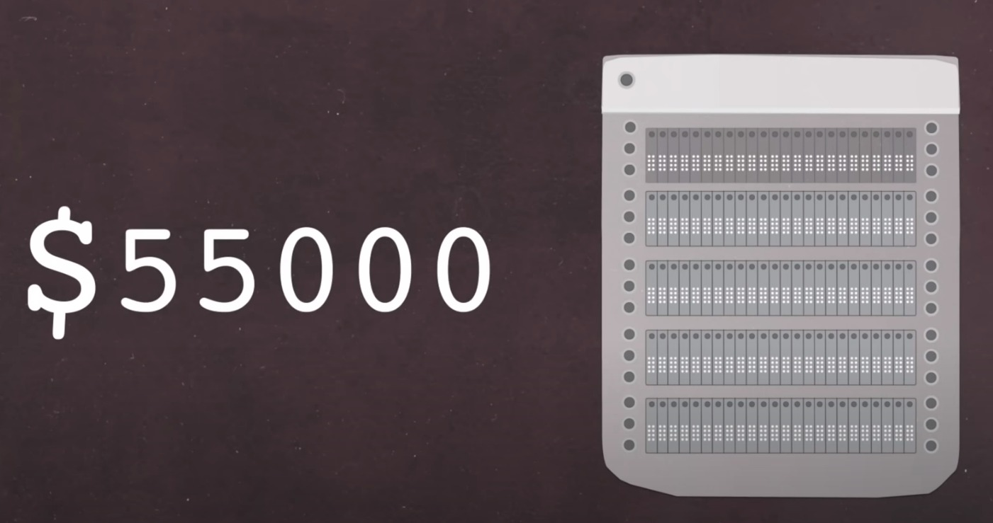
Which means we have a series of bubbles which are inflated by fluid or air
8 years ago University of Michigan tried to create digital Braille system which is entirely pneumatic
We really feel that one of consequences for blind people of not being able to access Braille is that they are limited in terms of the kind of science and mathematical things
Cons : Not affordable by visually impaired students and it is not compact. This protype is purely based on pneumatics which increase it’s size and not ease to carry. It is also not practically possible.

Slide 17
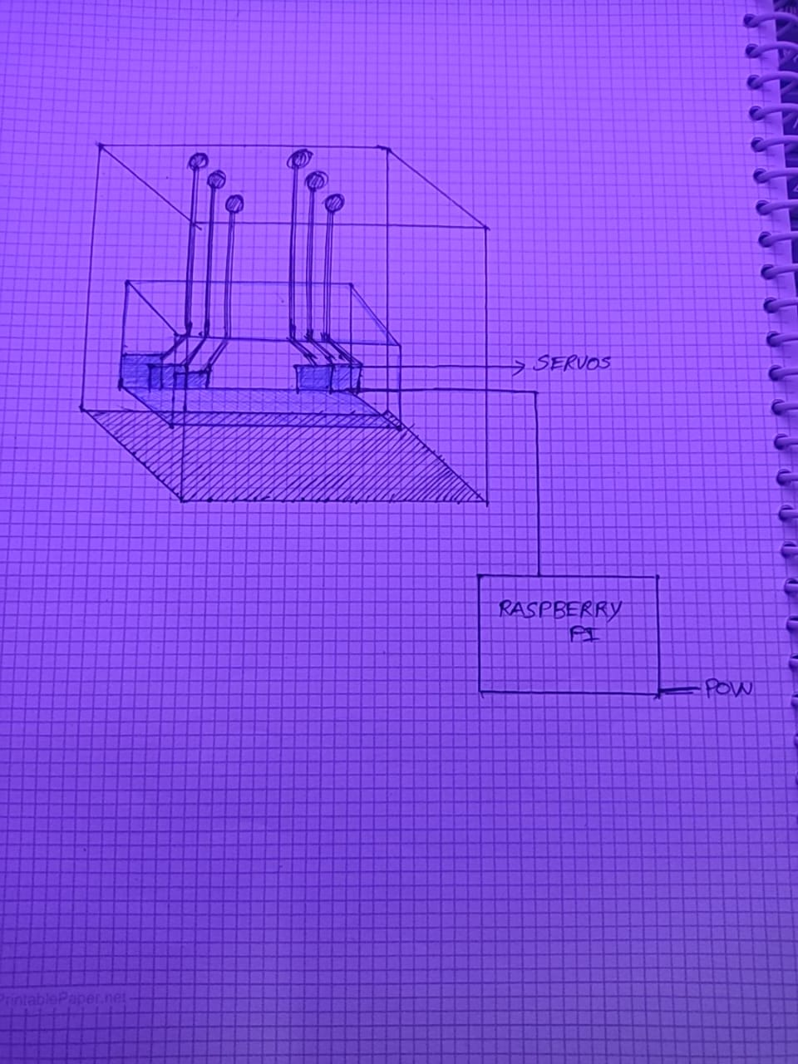
Cons : Not affordable by visually impaired students and it is not compact. This protype is purely based on pneumatics which increase it’s size and not ease to carry. It is also not practically possible.
Which means we have a series of bubbles which are inflated by fluid or air
Which means we have a series of bubbles which are either inflated or not

Slide 18
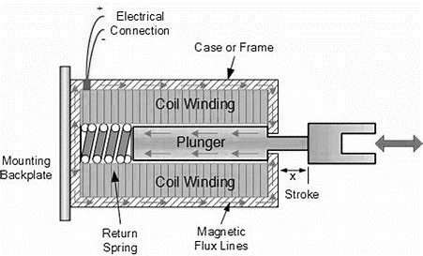
PROTOTYPE
In our prototype we are using low power solenoid for the eBraille Vision, for demonstration purposes now we're using servos. Which converts any text or equation into Braille which breaks the limitation for visually impaired students to learn science and mathematical things.
Cons : Not affordable by visually impaired students and it is not compact. This protype is purely based on pneumatics which increase it’s size and not ease to carry. It is also not practically possible.
Which means we have a series of bubbles which are either inflated or not

Slide 19
PROTOTYPE
In our prototype we are using low power solenoid for the eBraille Vision, for demonstration purposes now we're using servos. Which converts any text or equation into Braille which breaks the limitation for visually impaired students to learn science and mathematical things.

Slide 20
CONCLUSION
eBraille Vision will create a significant impact on the EdTech
THANK YOU

Slide 21
CONCLUSION
THANK YOU

